Slide 1
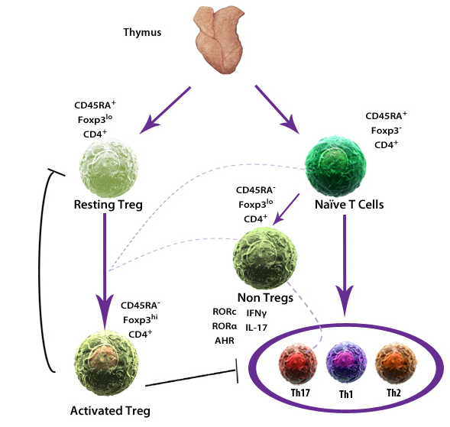
Human Treg Classes Balance Immunosuppression
Resting Tregs (rTregs), Activated Tregs (aTregs), and non Tregs are identified by the expression level of specific cell markers (CD45RA, Foxp3, CD4).
rTregs, when stimulated, can increase Foxp3 expression, convert to an aTreg, and proliferate. Several mechanisms prevent the excessive accumulation of aTregs.
Adapted from: Miyara M., et al. 2011. Autoimmun. Rev. 10:744.
®
Notes:
As mouse and human markers for Tregs can differ, the CD45RA marker is used in conjunction with Foxp3 to denote 3 distinct human Treg populations. Treg phenotypes are: rTregs (CD45RA⁺, Foxp3^{lo}, and CD4⁺); aTregs (CD45RA⁻, Foxp3^{high}, and CD4⁺); Non Tregs (CD45RA⁻, Foxp3^{lo}, and CD4⁺). There are a number of methods that prevent aTregs from continuously suppressing immune responses. These methods include the rapid death of aTregs following activation and the negative feedback loop of aTregs preventing the conversion of additional rTregs to aTregs. Non Tregs have a propensity of expressing Th17 related factors.

