Slide 1
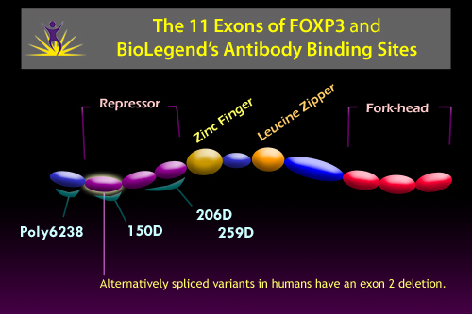
Method for FOXP3 Staining
CD4/CD25 surface stain
fix/perm
FOXP3 intracellular stain
Humans have two isoforms of FOXP3: full-length FOXP3 and the other (FOXP3 δ2) lacking exon 2.
The150D antibody recognizes FOXP3 epitope encoded by exon 2 in humans, mouse and rat T regs. Clone 206D and 259D recognize a human FOXP3 epitope in the region of amino acids 105-235.
®

