Slide 1
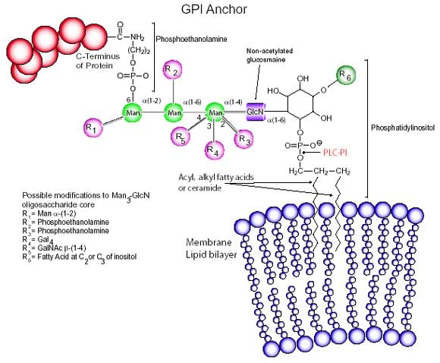
GPI Anchoring
Glycosylphosphatidylinositol (GPI anchor) is a glycolipid that can be attached to the C-terminus of a protein during posttranslational modification. It is composed of a phosphatidylinositol group linked through a carbohydrate-containing linker (glucosamine and mannose glycosidically bound to the inositol residue) to the C-terminal amino acid of a mature protein.
Their functionality ranges from enzymatic to antigenic and adhesion. GPI anchors direct proteins to membrane locations such as apical surfaces and lipid rafts. GPI-anchored proteins also play a critical role in a variety of receptor-mediated signal transduction pathways.
CD55 and CD59 are two GPI-anchored proteins that protect cells against complement.
®
Notes:
.

