Slide 1
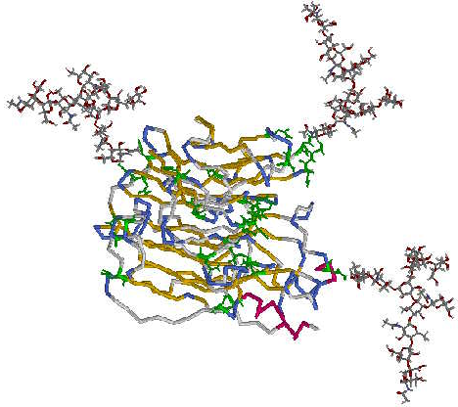
Glycosylation
Enzymatic process that links saccharides to produce glycans, attached to proteins, lipids, or other organic molecules
Functions:
Assists in proper protein folding in ER and Golgi.
Exerts net negative charge to the cell surface.
Major component of extracellular matrix and mucosal secretions.
Improve the half-life of proteins in blood.
Serve as ligands for lectins (Galectins, Selectins, Siglecs, etc.).
®
Notes:
.

