Slide 1
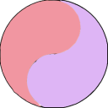
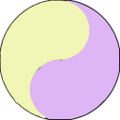
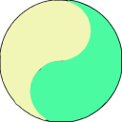
IL-12 Family of Cytokines
IL-23
IL-12
IL-27
IL-35
p19
p40
p35
p40
p28
Ebi3
p35
Ebi3
Every member of the IL-12 family of cytokines is made up of a heterodimer. IL-12 and IL-23 share the p40 subunit, while IL-27 and IL-35 share the Ebi3 subunit.
Inflammatory family members include IL-12 and IL-23. IL-12 is involved with IFNγ induction and generating a Th1 bias. IL-23 is made in response to pathogens and supports Th17 cells.
IL-27 and IL-35 are mainly inhibitory. IL-27 limits inflammation, while IL-35 is associated with a newly classified group of Tregs (iTr35).
Adapted from Vignali, D.A., and Kuchroo, V.K. 2012. Nat. Immunol. 13: 722
IL-23R
IL-12Rβ1
IL-12Rβ2
IL-12Rβ1
IL-27R
gp130
IL-12Rβ2
gp130
Jak2
Tyk2
Jak2
Tyk2
Jak2
Jak1
Jak2
Jak1
STAT3
STAT4
STAT4
STAT4
STAT3
STAT1
STAT4
STAT1
Proinflammatory Inhibitory
®
Notes:
iTr35 are induced by IL-35 and do not express Foxp3, IL-10, or TGF

