Slide 1
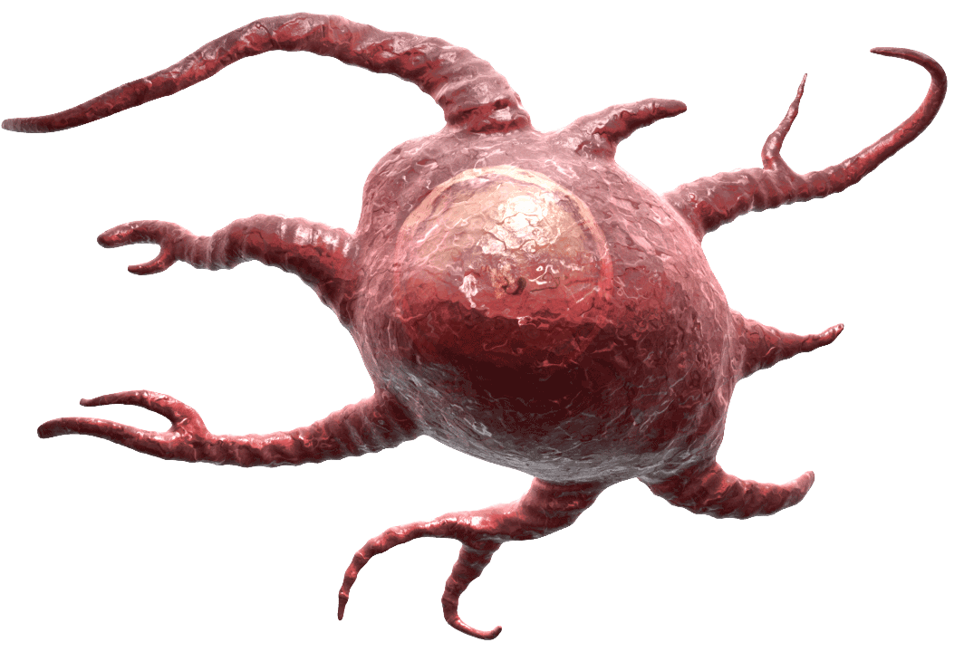
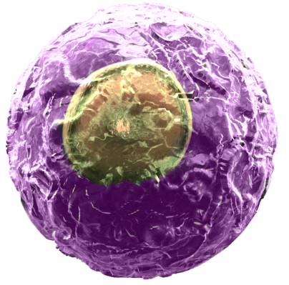
Meet the Ikaros Family
TGF-β
The Ikaros family consists of Ikaros, Aiolos, Helios, Eos, and Pegasus.
Ikaros can be found in T and B cells, controlling hematopoietic function, while Aiolos is involved with lymphocyte differentiation. Functionally, Eos and Pegasus are not as well defined.
Gottschalk et al. demonstrated Helios can actually be found in both Tregs and inducible Tregs (iTregs). Helios⁺ iTregs required antigen presenting cells for activity and were shown to have more regulatory ability than Helios⁻ iTregs.
Adapted from Zabransky, D.J., et al. 2012. PLoS ONE. 7:e34547 and Gottschalk, R.A., et al. 2013. J. Immunol. 188:976.
IL-2
Naïve CD4⁺ T cell
Dendritic Cell
Helios
CD103
GITR
Helios⁺ iTreg
Helios⁻ iTreg
Enhanced
Immunosuppression
Immunosuppression
®
Notes:
Initial studies suggested Helios was a natural Treg specific marker. Gottschalk’s paper contradicts this original notion.
In addition to antigen presenting cell contact, IL-2 and TGFβ were important for generating Helios+ iTreg suppressive activity.
Helios+ iTregs increase expression of Helios, CD103, and GITR compared to Helios- iTregs.

