Slide 1
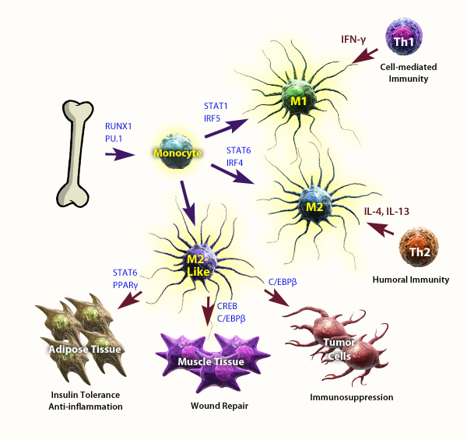
Macrophage Classes and Roles in Immunity
Macrophages (Mφ) can be promoted to a M1 or M2 phenotype via IFNy and IL-4 respectively.
While M1 cells promote inflammation and the clearance of infection, M2 cells push for tolerance and help prevent inflammation.
Adapted from: Lawrence, T. and Natoli, G. 2011. Nature Immunol. Rev. 11:750.
®
Notes:
After the initial immune response is mounted, M1s can convert into M2s, promoting tolerance and limiting inflammatory responses. In adipose tissue, M2-like Mφ promote tolerance to insulin and prevent inflammation. Myeloid-derived suppressor cells (MDSCs) bare many similarities to M2 cells. They often promote a Th2 cells and an anti-inflammatory environment, allowing tumors to develop in certain situations.

