Slide 1
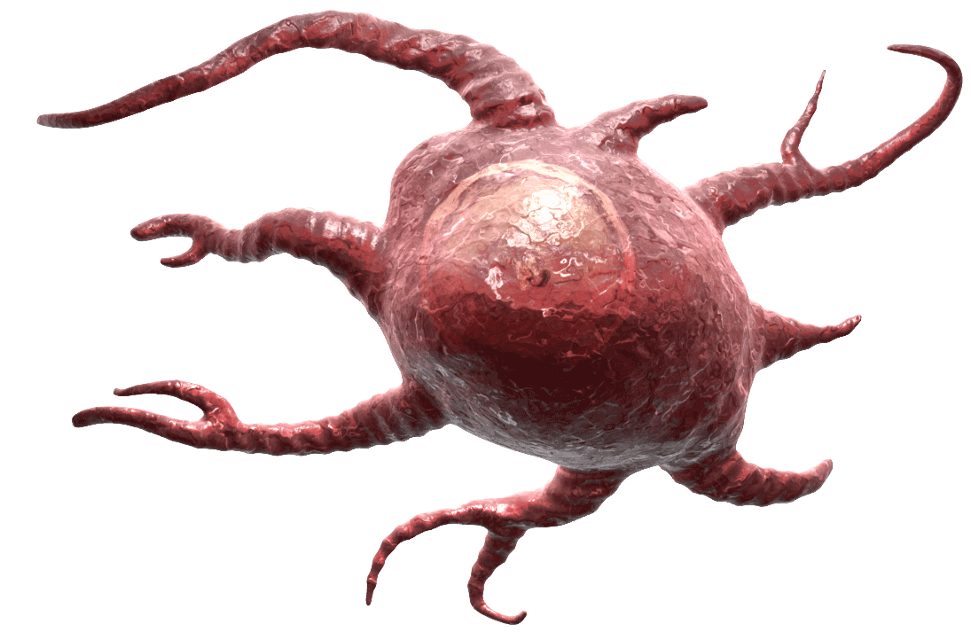
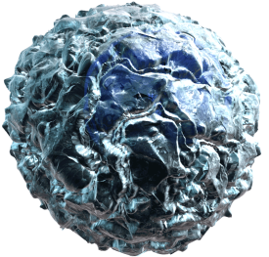
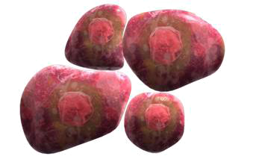
NK Cells Fighting Cancer
Yac-1 Cell
NK cells are stimulated by Yac-1 cells due to their lack of MHC I expression.
NK cells lyse immature dendritic cells with perforin. Therefore, only mature dendritic cells survive. Mature dendritic cells then promote a Th1 response.
Mice were protected from injected carcinomas if they were treated with Yac-1 cells first, meaning NK cells could potentially help fight back against cancer.
Adapted from: Morandi, et al. 2012. PLoS One. 7: e39170.
Perforin
NK Cell
Immature Dendritic Cell Lysis
TNFα, Proinflammatory Cytokines
Mature Dendritic Cell
Th1 Cell
IFNγ
Tumor Cell Destruction
®

