Slide 1
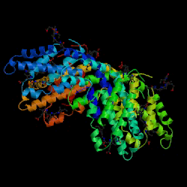
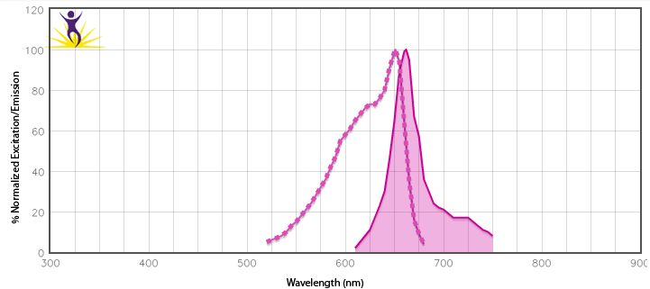
Phycobiliprotein: Allophycocyanin
Large multi-subunit, globular (~110 kDa) protein derived from algae.
6 chromophores per molecule
High quantum yield (bright)
Ex = 633 nm, Em = 660 nm
Why use APC?
High QY and EC make it an intense, efficient donor molecule for FRET.
®

