Slide 1
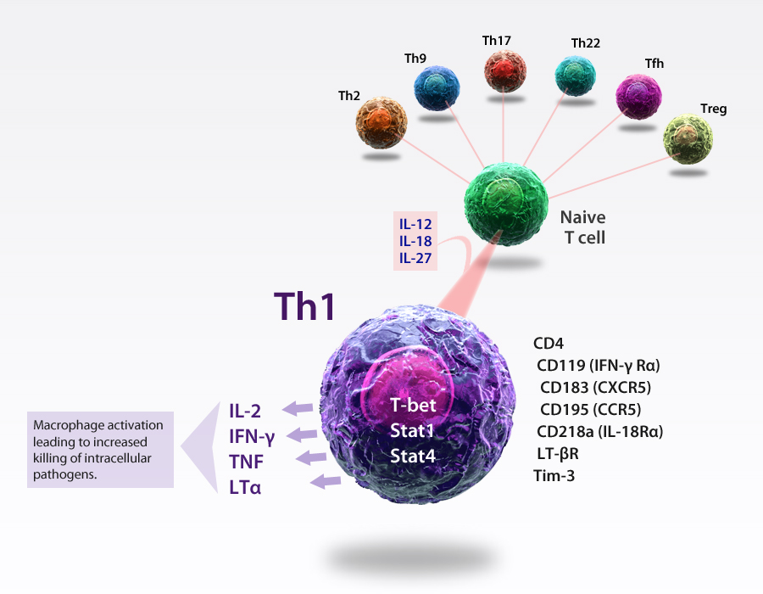
Th1 Cells
Th1 cells are T helper cells, essential to cell-mediated immunity, that drive the killing efficacy of macrophages and proliferation of cytotoxic CD8 T cells in response to intracellular pathogens. Th1 cells are characterized by the expression of the transcription factor T-bet and produce cytokines: IL-2, IFN-γ, TNF, and LT-α. Th1 cells are associated with several chronic inflammatory diseases, including multiple sclerosis, diabetes, and rheumatoid arthritis.
®

