Slide 1
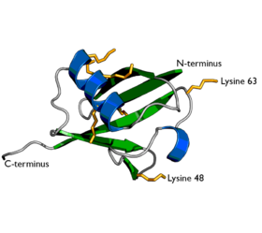
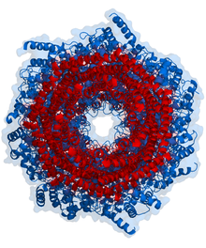
Ubiquitination
Post-translational modification of a protein by the covalent attachment of one or more ubiquitin monomers. The most prominent function of ubiquitin is labeling proteins for proteasomal degradation. Ubiquitination also controls the stability, function, and intracellular localization of a wide variety of proteins.
The Proteosome
®
Notes:
.

