Slide 1
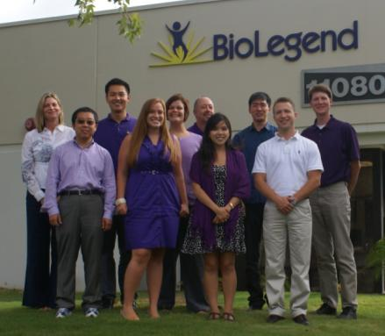
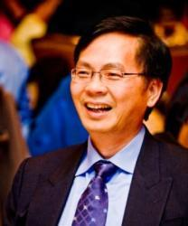
Who is BioLegend?
BioLegend develops and manufactures world-class, cutting-edge antibodies and other immunological reagents for biomedical research, offered at an outstanding value.
What makes BioLegend different?
Customer service
Quality
Flexibility
Selection
Price
Resources
Gene Lay, D.V.M. - Founder and CEO
co-founder of PharMingen, now BD Biosciences
®

