Slide 1
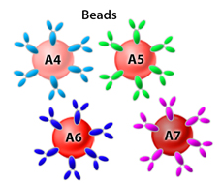
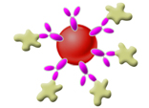
Principles of LEGENDplex™
Beads have different sizes and inherent APC fluorescence which corresponds to a specific analyte’s capture antibody.
…
A4: IFN-γ
A5: IL-5
A6: TNF-α
A7: IL-2
…
1
Beads are incubated with analyte containing samples, such as serum or cell culture supernatants.
2
+
Beads with captured analyte are incubated with biotinylated-detection antibody and Streptavidin PE.
+
3
4
Collect data using any flow cytometer.
®

