Slide 1
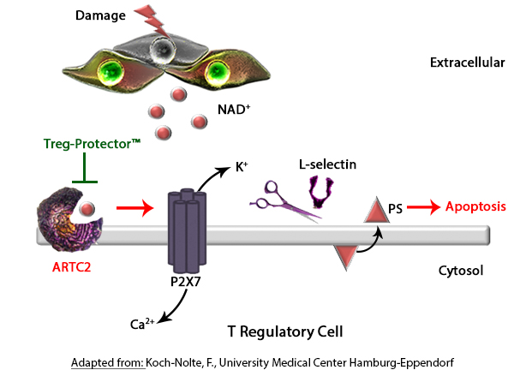
The Treg-Protector™
NAD⁺- induced cell death (NICD) severely limits the recovery of regulatory T cells from tissue.
1
Cells release NAD⁺ in response to cellular injury.
The enzyme ARTC2 binds NAD⁺, transferring ADP-ribose to ion transporters such as P2X7.
2
1
P2X7 activation induces apoptosis, causing calcium flux, cleavage of L-selectin, and exposure of phosphatidylserine.
4
3
3
2
The Treg-Protector™ is an anti-ARTC2 nanobody that blocks NAD⁺ binding to the enzyme, preventing NICD.
4
®

